Slide 1
K-Means on Word2Vec
CS - 677: Parallel Programming for Many-core Processors
By Brenden Brusberg

Slide 2
Objective
Word2Vec, K-Means, and the Approach

Slide 3
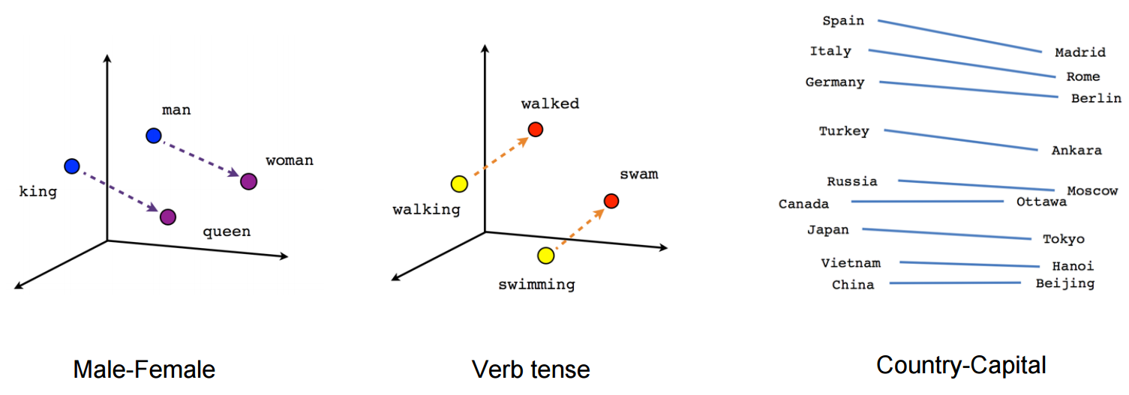
Word2Vec
Word2Vec is a google algorithm developed for natural language processing to transform a large corpus containing words into a word embedding.
The data used by this project is provided by the The Stanford NLP Group on their GloVe: Global Vectors for Word Representation project. I chose this data set because it provided consistently made data sized with different dimensions.

Slide 4
K-means
Finds distances from every vector to every centroid
Classify each vector to a centroid and update the centroid
The challenge with word embeddings is calculating the distance and updating the centroids in high dimension space (Greater than 50)

Slide 5
Parallelism
Distances: N vectors finding distance to K centroids (sqrt(Dim Subtrations+ Dim Squares)): N*K*(2*Dim+1)Operations
Can Parrelize over every vector
Updating Means: Centroids updating with classified vectors (Dim Subtrations + Dim Squares / (Count): K*(N/K) * (Dim Sum)
Can be reduce to sum dimensions of each newly classified centroid/cluster
Parameters
N: Vectors
K: Centroids
Dim: dimensions
Iter: Iterations

Slide 6
Kernels
Finding Distances
Labeling Vectors
Updating Centroids

Slide 7
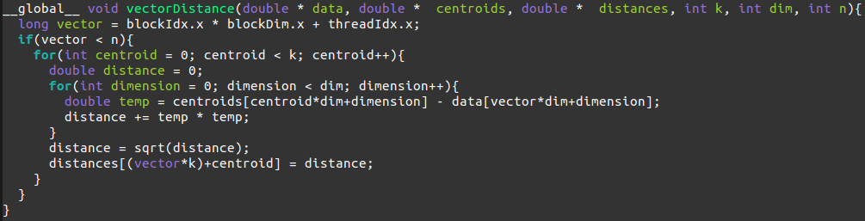
Finding Distance (Naive CPU to GPU)
Each thread chooses one vector, anc calculates its distance to every centroid
Very similar to CPU code
# of vectors = # of active threads, Near 100% Occupancy

Slide 8
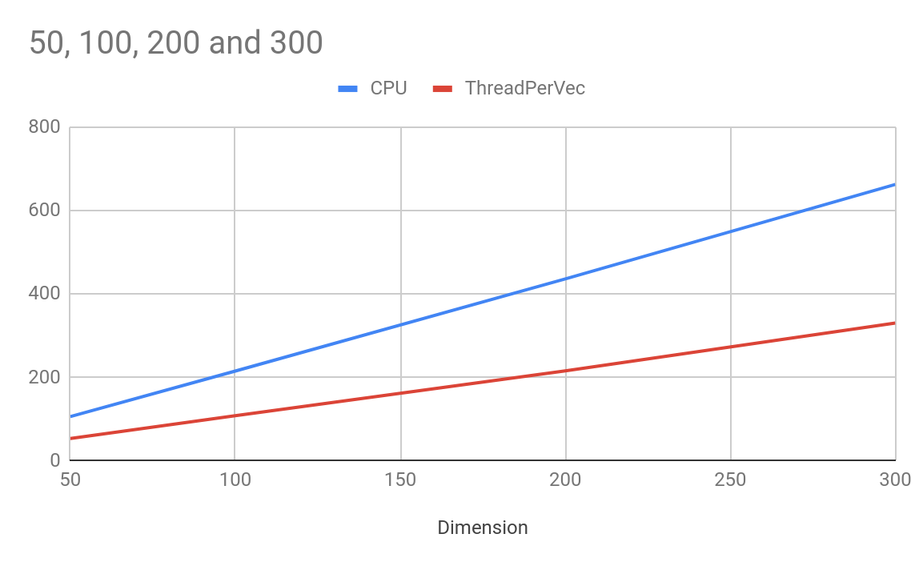
CPU vs GPU Naive Timing

Slide 9
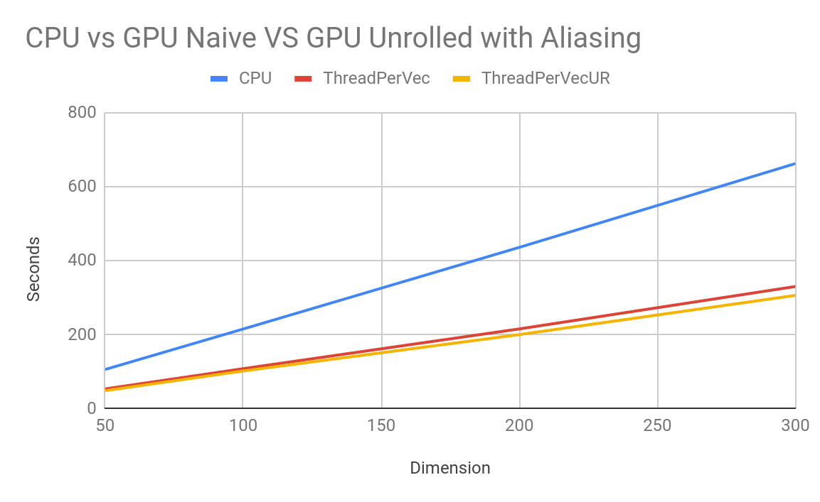
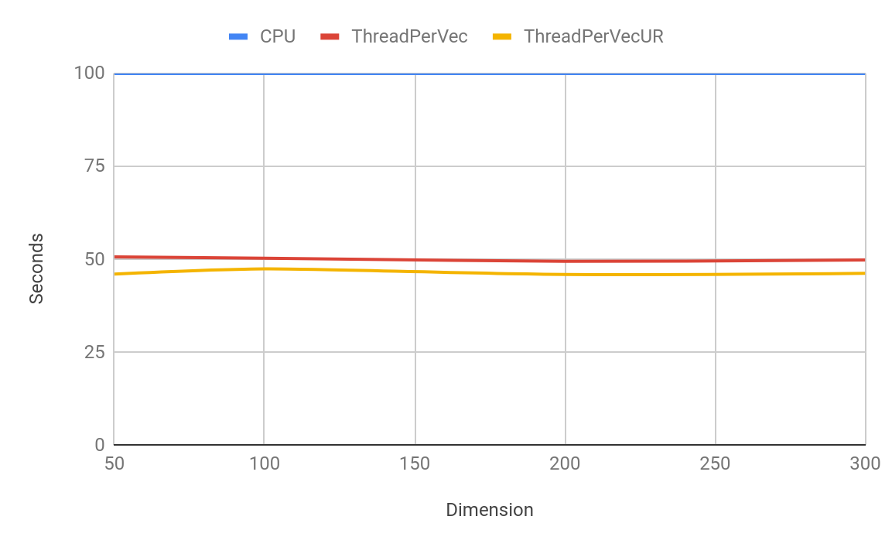
Unrolling, Restrict, Less Loads (Timings)
Unrolling over dimension
__restrict__ keyword for pointer aliasing
Not doing unnecessary reloads

Slide 10
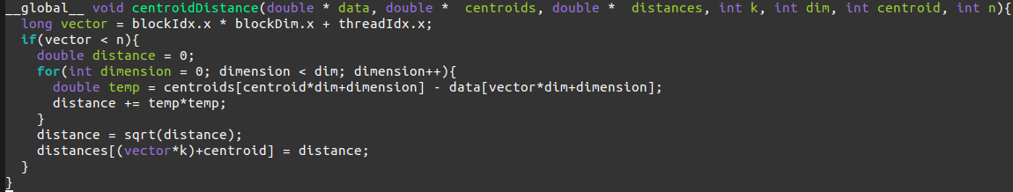
Thread Per Vector vs Thread per Centroid
Each thread choosing a vector to find its distances can not fit any full dimension of the data into shared memory
However, only focusing on one centroid at a time allows us to fit the centroids into shared and constant memory
K times more threads: Near 100% Occupancy, registers per thread fit and no shared memory is used
(# of vectors = # of threads) per centroid

Slide 11
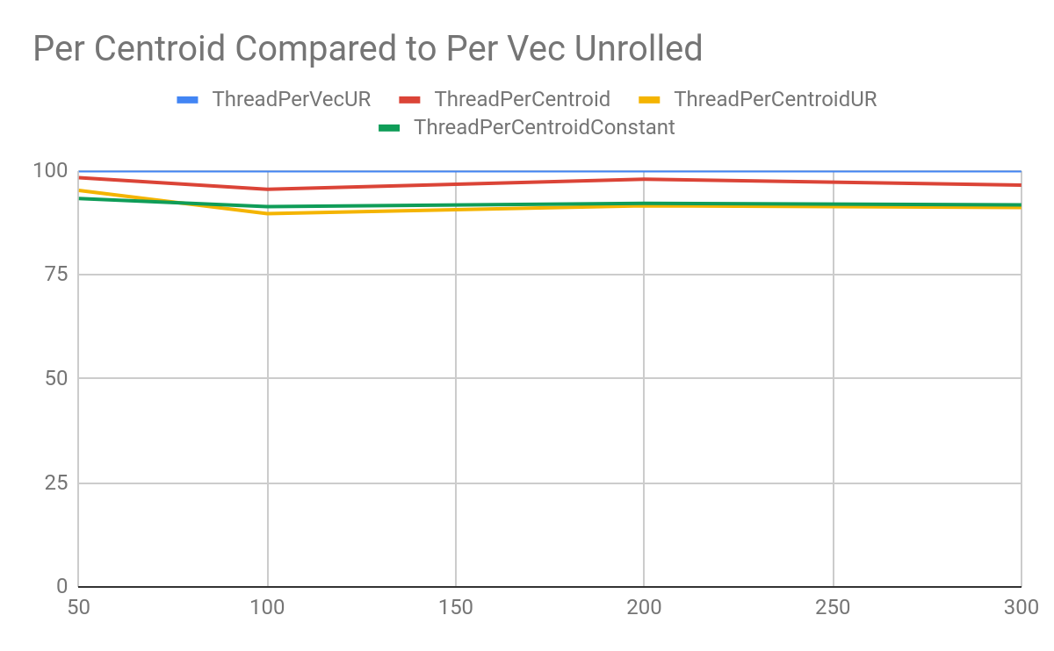
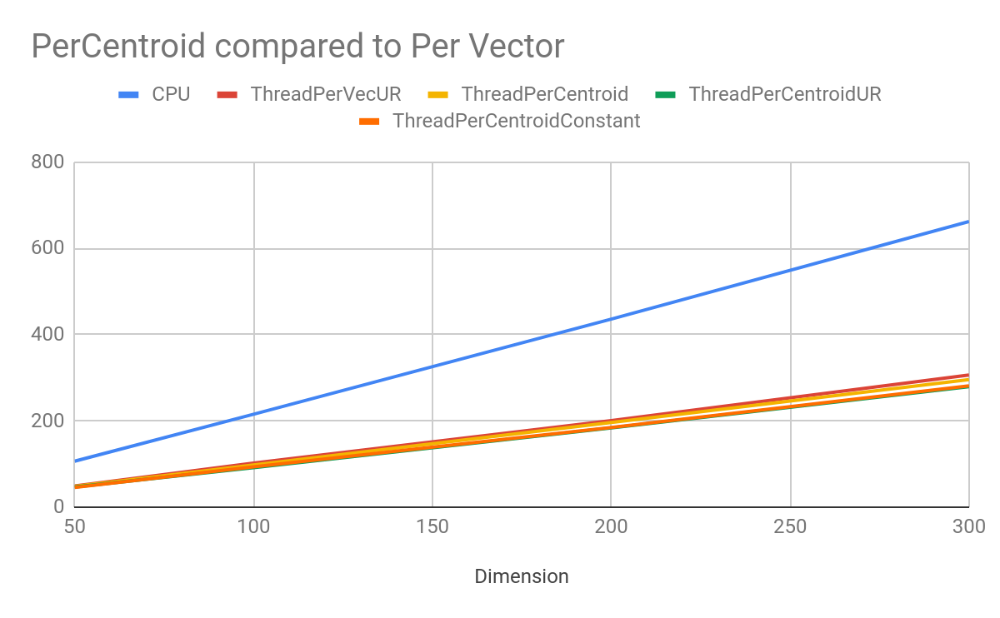
Constant Memory Vs Unrolling
Dimension | CPU | ThreadPerVecUR | ThreadPerCentroid | ThreadPerCentroidUR | ThreadPerCentroidConstant
50 | 106.451816 | 49.03403 | 48.220518 | 46.7211051 | 45.753836
100 | 215.450953 | 102.290229 | 97.726715 | 91.726715 | 93.488042
200 | 435.908109 | 200.456133 | 196.334971 | 183.60691 | 184.749737
300 | 662.311661 | 306.42629 | 295.828146 | 279.260112 | 281.205472
Constant memory did not mix well with loop unrolling

Slide 12
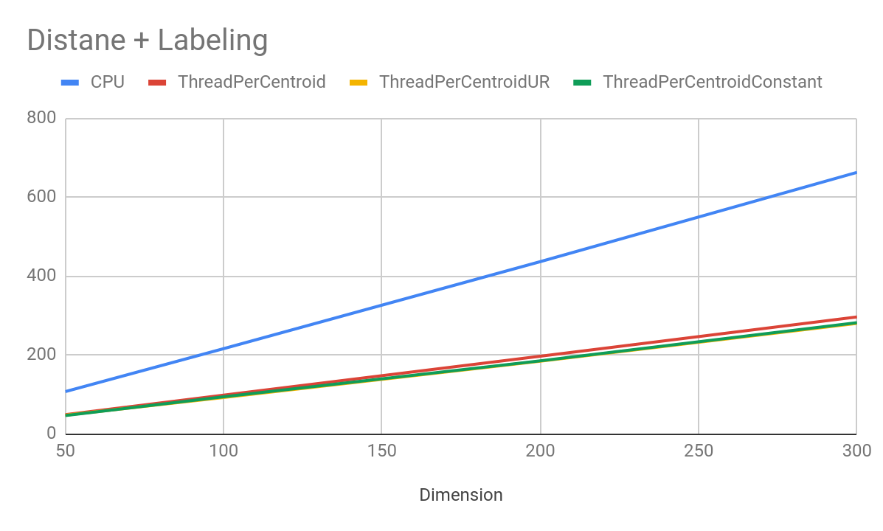
Labeling Mins
Labeling/classifying vectors to their clusters is useless with in its own kernel
Just a simple for loop over n threads, very light work that the CPU can do, only saving a couple seconds with most data dimensions
Added to Thread PerVector/Thread PerCentroid implementation
Dimension | CPU | PerVector | PerCentroid Constant | PerVector Unrolled
50 | 106.451816 | 46.264011 | 45.331835 | 45.487254
100 | 215.450953 | 99.887177 | 97.165904 | 93.673763
200 | 435.908109 | 200.876292 | 195.742083 | 184.893945
300 | 662.311661 | 310.010888 | 300.213158 | 282.088175

Slide 13
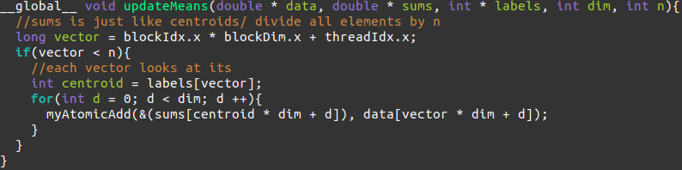
Atomics are useless
To update the centroids: vectors at the end can be labeled/classified by any cluster
Without sorting, the reduction must be made with atomics on global memory
AWS Compute Capability: 5.2, atomicAdd() on doubles not implemented until Compute Capability 6.0 and greater
atomicAdd() with doubles implemented with atomicCAS
Thrust, wasteful implementation
I am not going to show the times for these, often way slower than CPU

Slide 14
Reduction
Two Kernels:
Find the distances to every centroid, keep track of the closest centroid. Then reduce to find its sum distance over the block
This one just reduces over the blocks and does the final decision
Timing failed last night with high dimension data
2 Dimensional Data tests were averaging around a 60% to 80% reduction in times contrasted to unrolled and constant version of only find distances and labeling reduced round 50% to 60%
Occupancy is similar to reduction where it will quickly lose amount of threads performing work

Slide 15
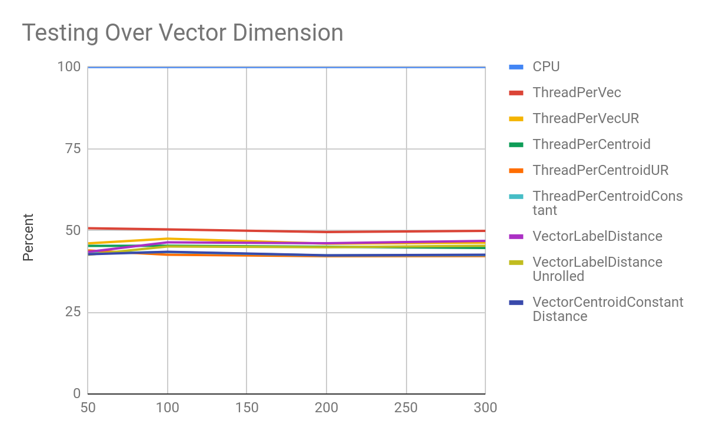
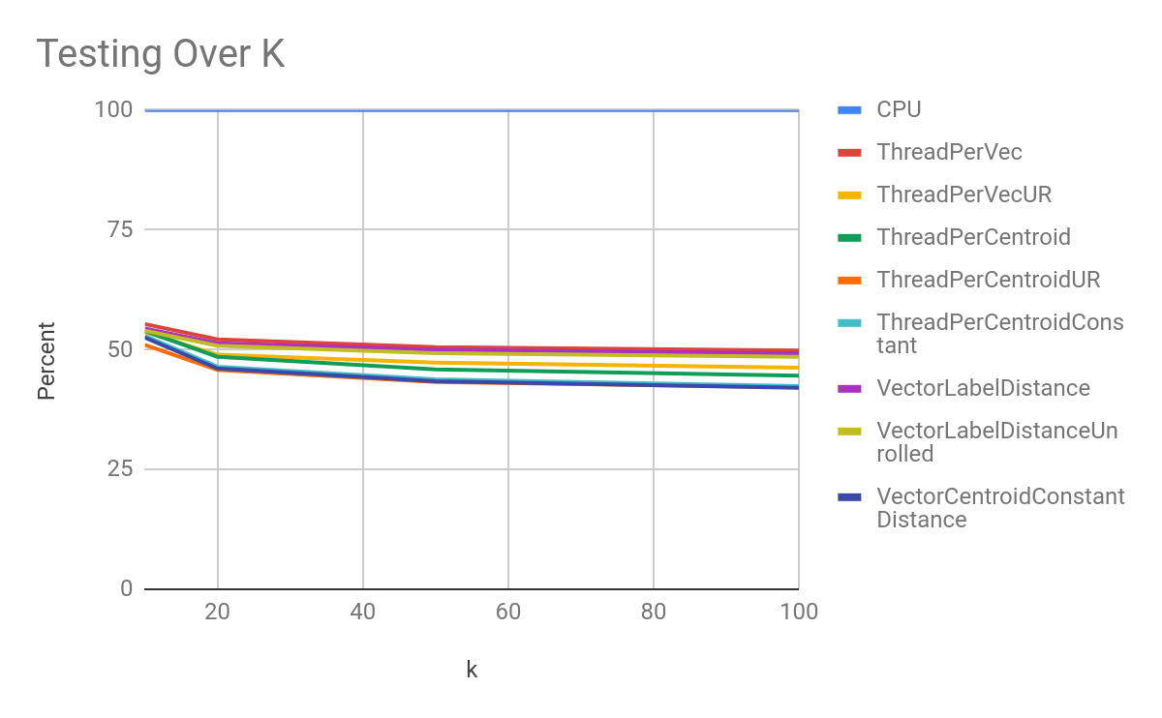
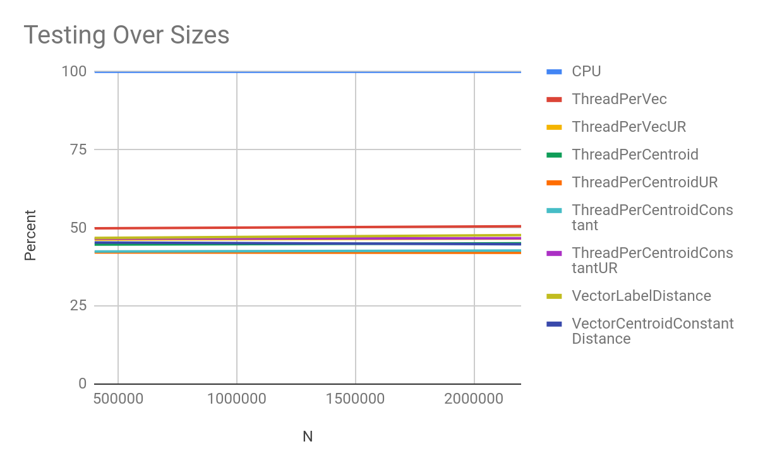
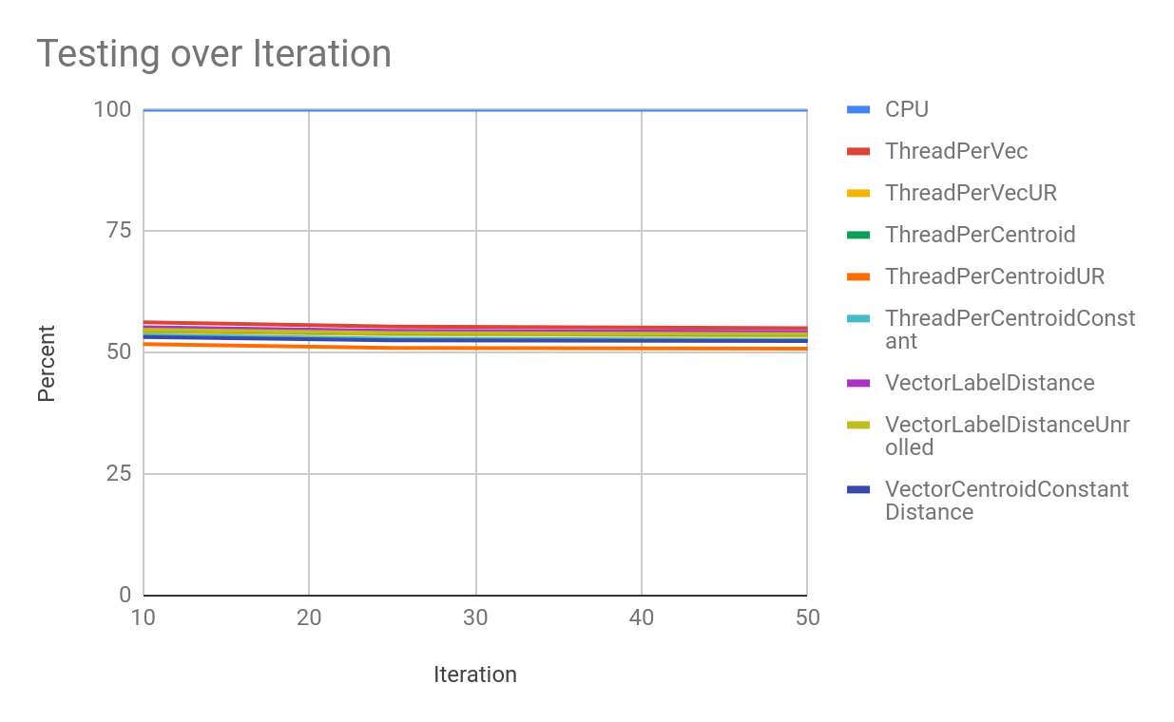
Analysis

Slide 16
Problems and Improvements
Using doubles instead of floats, float precision is not enough for the small values that represent the dimensions of the vectors, when millions are added together.
This doubles the size
Band-with
Hard to fit useful dimensions of the data into shared or constant memory
Disregarding reduction: all distance kernels require to either memcpy distances and/or centroids which are
N: 2.2 Million, k = 100, Dim = 300
Distances: (N * Dim * 8) bytes
Centroids: (k * dim * 8) bytes
Over 50 Iterations: 245.880335569 gigabytes over the whole process of transfer
Transferring at 6 GB/s to GPU memory: 40 Seconds just for memory transfer (Transfering can be as low as 1 GB/s)
If N = 400,000: Roughly 10 Seconds for Memory transfer

Slide 17
Questions?
Stanford GLoVe Data Set: https://nlp.stanford.edu/projects/glove/
My Implementation: https://github.com/brusberg/Word2Vec_Kmeans
Permalink to Slides:
https://docs.google.com/presentation/d/1RJFZQV672soR5VU5LIGxUnIF55jFXz_K019BcO41VBg/edit?usp=sharing

